Slide 1
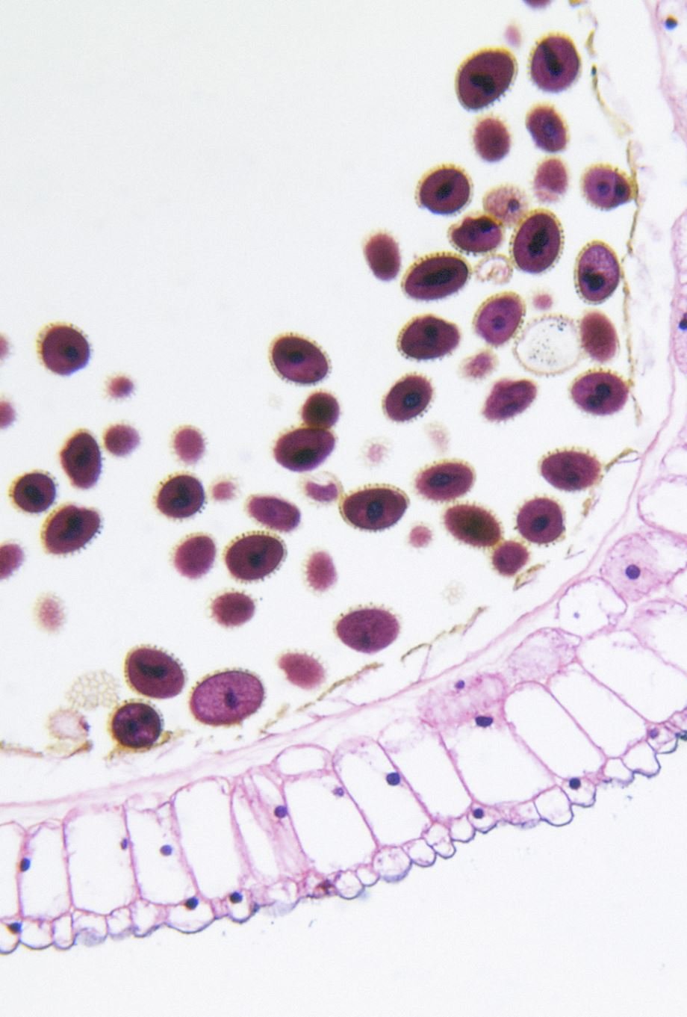
Skin Lesion Classifications using Deep Learning
Name :Vasu Kalariya
Roll No: PE29
Panel: E
Department : (Computer Engineering and Technology)
Programme : T.Y. BTech
Guide Name : Dr. Pradnya Kulkarni

Slide 2
OUTLINE
Introduction & Motivation
Background
Literature Review
Research Gap
Base Paper Explanation
Conclusion
References

Slide 3
INTRODUCTION & MOTIVATION
Skin Cancer is the most common and potentially life-threatening type of cancers.
In 2019, It was diagnosed in about 5.6 million individuals.
It affects 2.5 million people annually in countries such as Australia, New Zealand, South Africa and the US
The estimated 5-year survival rate is over 95% for early stage diagnosis
The estimated survival rate is below 20% for late stage detection.

Slide 4
BACKGROUND
Skin has three layers : The epidermis, The dermis, The Hypodermis
Skin Cancer is the abnormal growth of cells in the dermis or epidermis that has the ability to spread to certain parts of the human body
Skin lesions are broadly classified into Malignant and Benign.
Benign Skin lesions :
Actinic keratoses.
Benign keratosis-like lesions.
Dermatofibroma.
Melanocytic nevi
Vascular lesions.
Malignant skin lesions :
Non-melanoma Skin Cancer
Melanoma Skin Cancer

Slide 5
LITERATURE REVIEW
Sr No | Title of the paper | Author | Year of publication | Dataset used | Methods used | Accuracy | Research Gap
1 | DEEP LEARNING FOR SKIN CANCER DIAGNOSIS WITH HIERARCHICAL ARCHITECTURES | Catarina Barata, Jorge S. Marques. | 2019 (IEEE) | ISIC 2017 | HIERARCHICAL CNN | 87.6% | Validation of results on a larger dataset that comprises more classes of non-melanocytic lesions is required.
2. | SKIN LESION CLASSIFICATION USING HYBRID DEEP NEURAL NETWORKS | Amirreza Mahbod, Gerald Schaefer, Chunliang Wang, Rupert Ecker, Isabella Ellinger. | 2019 (IEEE) | International Skin Imaging Collaboration 2016, 2017 | Convolutional Neural Networks (CNNs) | 90.69 % | Extending the model to incorporate more advanced pre-trained models such as DenseNets could improved classification performance

Slide 6
LITERATURE REVIEW
Sr No | Title of the paper | Author | Year of publication | Dataset used | Methods used | Accuracy | Research Gap
3. | Skin Lesion Classification using Deep Learning and Image Processing | Atharva Jibhakate, Pranav Parnerkar, Sahil Mondal, Vastav Bharambe, Shamla Mantri | 2021 (IEEE) | Skin Cancer MNIST: HAM10000 | ConvolutionalNeural Networks (CNNs), Transfer learning | 99% | Novelness is minimised as the authors have relied more on the transfer learning approach and used pretrained architectures.
4. | Attention Residual Learning for Skin Lesion Classification | Jianpeng Zhang, Yutong Xie, Yong Xia, Chunhua Shen | 2019 (IEEE) | ISIC-skin 2017 | Attention Residual Learning | 91.7% | Lesions are classified only into two types cancerous and non-cancerous

Slide 7
LITERATURE REVIEW
Sr No | Title of the paper | Author | Year of publication | Datasets used | Methods used | Accuracy | Research Gap
5. | FCN-Based DenseNet Framework for Automated Detection and Classification of Skin Lesions in Dermoscopy Images | ADEKANMI A. ADEGUN, SERESTINA VIRIRI | 2020 (IEEE) | HAM10000 | Fully Convolution Network (FCN) | 98% | The encoder-decoder network has less accuracy compared to integrated with the CRF model
6 | Skin lesion classification using GAN based data augmentation | Haroon Rashid, M Asjid Tanveer, Hassan Aqeel Khan | 2019 (IEEE) | International Skin Imaging Collaboration 2018 | Generative Adversarial Networks (GANs) | 86% | Architecture can be more customized for data generation and classification lesions is required.

Slide 8
LITERATURE REVIEW
Sr No | Title of the paper | Author | Year of publication | Datasets used | Methods used | Accuracy | Research Gap
7. | Skin lesion classification with ensembles of deep convolutional neural networks | B Harangi | 2018 - Elsevier | ISBI 2017 | deep convolutional neural networks | 89.1% | The proposed CNN framework need extension using additional CNN networks and customization for actual usage.
8 | Deep Learning for Two-Step Classification of Malignant Pigmented Skin Lesions | Sertan Kaymak, Parvaneh Esmaili, Ali Serener | 2018 (IEEE) | 2018 ISIC | Two-step Deep Learning | 84% | Architecture was not able to fully differentiate between non-melanocytic malignant and benign skin lesion images

Slide 9
LITERATURE REVIEW
Sr No | Title of the paper | Author | Year of publication | Datasets used | Methods used | Accuracy | Research Gap
9. | The Development of a Skin Cancer Classification System for Pigmented Skin Lesions Using Deep Learning | Shunichi Jinnai, Naoya Yamazaki, Yuichiro Hirano, Yohei Sugawara, Yuichiro Ohe, Ryuji Hamamoto | 2020 - Biomolecules | Dataset was created from scratch | FRCNN | 86.2% | Architecture was facing difficulty identifying from low-resolution images, due to its weak capacity to identify local texture
10 | Skin Lesion Segmentation and Classification using Traditional Classifiers with Hand-Crafted Features | Russell C. Hardie, Redha Ali, Manawaduge Supun De Silva, Temesguen Messay Kebede | 2018 (ISIC) | 2018 ISIC dataset | Support Vector Machine | 70% | The classifier Performance can be improved with more images

Slide 10
RESEARCH GAP
Extending the model to incorporate more advanced pre-trained models such as DenseNets could improved classification performance
Novelness is minimised as the authors have relied more on the transfer learning approach and used pretrained architectures.
The classifier performance can be improved with more number images
Lesions are classified only into two types cancerous and non-cancerous
The encoder-decoder network has less accuracy compared to integrated with the CRF model

Slide 11
RESEARCH GAP
Validation of results on a larger dataset that comprises more classes of non-melanocytic lesions is required.
The proposed CNN framework need extension using additional CNN networks and customization for actual usage.
Architecture was not able to fully differentiate between non-melanocytic malignant and benign skin lesion images
Architecture was facing difficulty identifying from low-resolution images, due to its weak capacity to identify local texture
The classifier Performance can be improved with more images

Slide 12
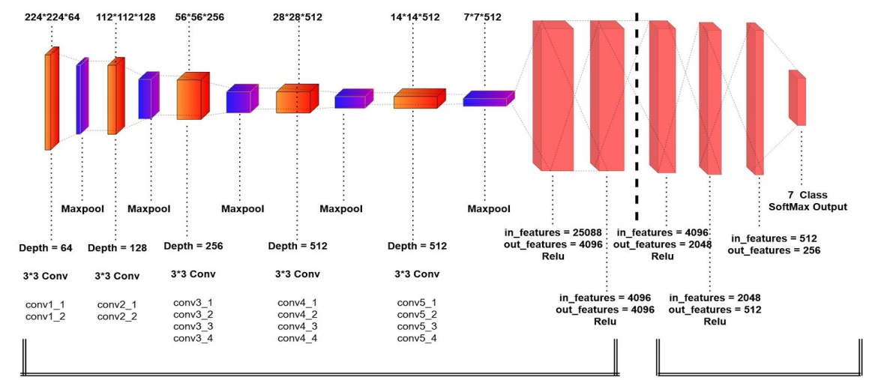
BASE PAPER DETAILS
Paper Name : Skin Lesion Classification using Deep Learning and Image Processing.
Published in : 2020 3rd International Conference on Intelligent Sustainable Systems (ICISS)
Dataset : Skin Cancer MNIST: HAM10000.
Network Architecture :

Slide 13
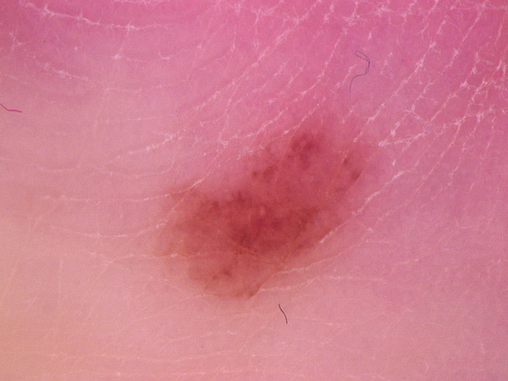
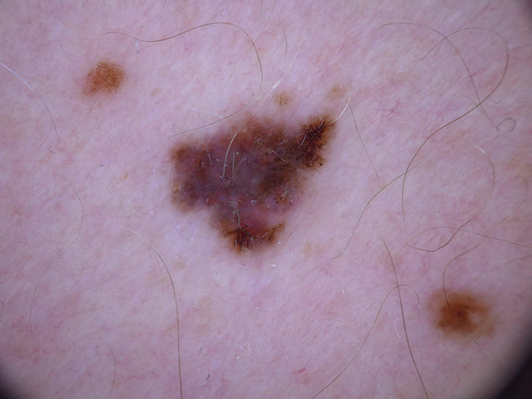
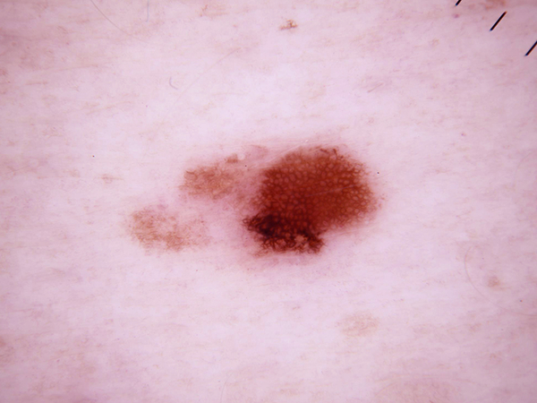
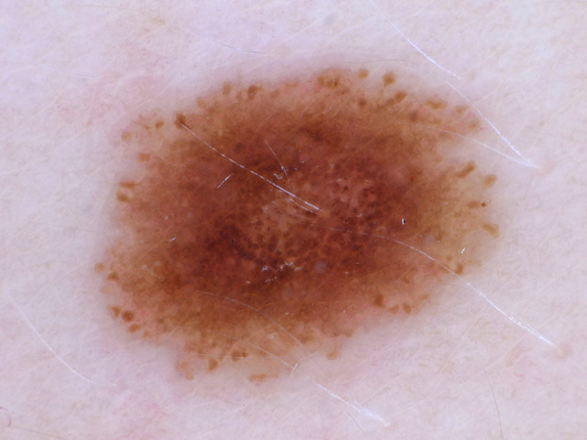
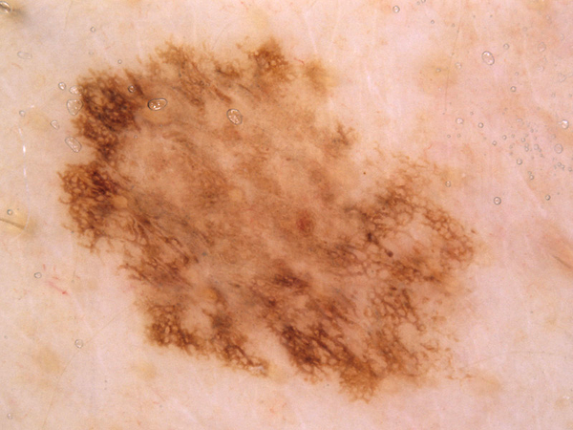
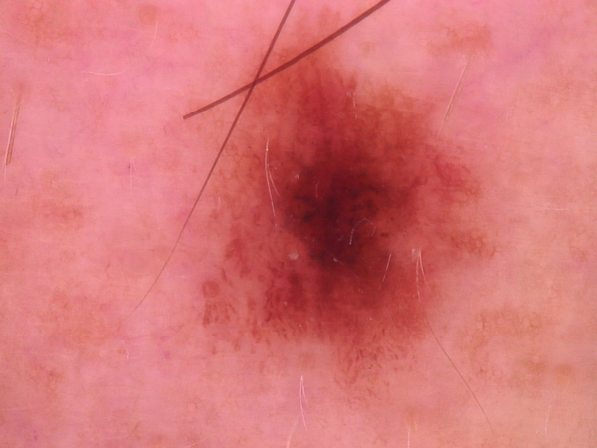
BASE PAPER DETAILS : DATASET SAMPLES

Slide 14
BASE PAPER DETAILS
5. Implementation steps
Pre-processing
Firstly eliminate duplicates (images having the same lesion id) from the dataset.
splitting the dataset into training and validation sets.
A factor of 0.1 for transfer learning models and a factor of 0.2 for the CNN model
Normalization of images.
Lastly, the images in the training set are augmented by rotating and flipping them horizontally and vertically

Slide 15
BASE PAPER DETAILS
5. Implementation steps
Modelling - VGG19
Number of convolutional layers are sixteen fully connected are three.
The size of the convolutional kernel is 3x3 and the input size is 224x224x3.
utilise max-pooling for down sampling and modify the linear unit (ReLU) as the activation function.
Max-pooling is utilized for down sampling and modify the linear unit (ReLU) as the activation function.

Slide 16
BASE PAPER DETAILS
5. Implementation steps
Modelling - DNN
Deep neural network is comprised of a sequential block having four linear layers.
First three were activated using ReLU function
Output Layer is activated with Softmax Layer.
Output Softmax layer has seven different classes.

Slide 17
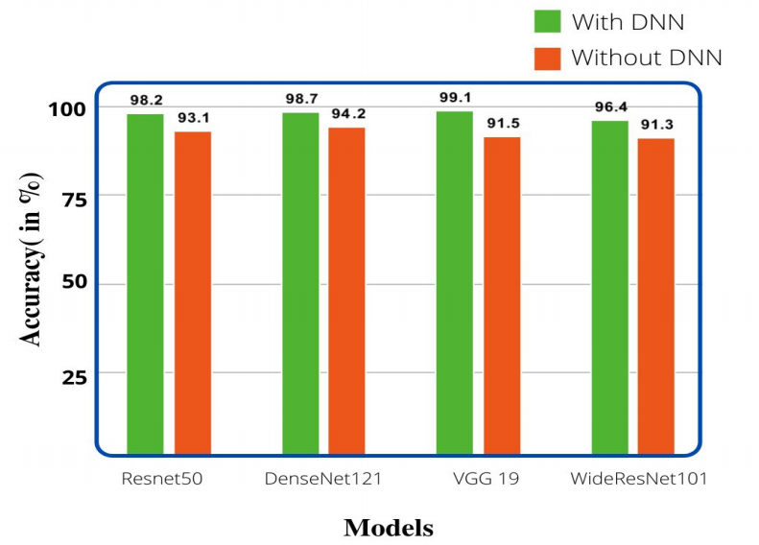
Base Paper Results
Classification Result :

Slide 18
CONCLUSION
The power of deep neural networks in the classifying dermatoscopic images of seven major skin lesions, which if used in the real world, can provide diagnosis which potentially could be life-saving.
After analysing all the 5 models, the most promising result was obtained using VGG-19 Network which delivered best accuracy
Using these modified networks, better visual diagnostic precision is obtained as compared to an expert or clinician.
The ease of implementation clearly exhibits the potential of these models being used in dermatoscopic systems and modern smartphones in the near future.

Slide 19
SELECTED REFERENCES
Atharva Jibhakate, Pranav Parnerkar, Sahil Mondal, Vastav Bharambe, Shamla Mantri, "Skin Lesion Classification using Deep Learning and Image Processing", 2021 IEEE
Amirreza Mahbod, Gerald Schaefer, Chunliang Wang, Rupert Ecker, Isabella Ellinger, "SKIN LESION CLASSIFICATION USING HYBRID DEEP NEURAL NETWORKS", 2019 IEEE.
Jianpeng Zhang, Yutong Xie, Yong Xia, Chunhua Shen, "Attention Residual Learning for Skin Lesion Classification", 2019 IEEE
Haroon Rashid, Asjid Tanveer, Hassan Aqeel Khan, "Skin lesion classification using GAN based data augmentation", 2019 IEEE.
Adekamni A. Adegun, Serestina Viriri, "FCN-Based DenseNet Framework for Automated Detection and Classification of Skin Lesions in Dermoscopy Images", 2020 IEEE

Slide 20
SELECTED REFERENCES
Catarina Barata, Jorge S. Marques "DEEP LEARNING FOR SKIN CANCER DIAGNOSIS WITH HIERARCHICAL ARCHITECTURES" ,2019 IEEE.
B Harangi "Skin lesion classification with ensembles of deep convolutional neural networks" , 2018 Elsevier
Sertan Kaymak, Parvaneh Esmaili, Ali Serener "Deep Learning for Two-Step Classification of Malignant Pigmented Skin Lesions " , 2018 IEEE.
Shunichi Jinnai, Naoya Yamazaki, Yuichiro Hirano, Yohei Sugawara, Yuichiro Ohe, Ryuji Hamamoto "The Development of a Skin Cancer Classification System for Pigmented Skin Lesions Using Deep Learning" , 2020 Biomolecules
Russell C. Hardie, Redha Ali, Manawaduge Supun De Silva, Temesguen Messay Kebede "Skin Lesion Segmentation and Classification using Traditional Classifiers with Hand-Crafted Features" , 2018 ISIC

Slide 21

THANK YOU

